Slide 1
Community Emergency Response Team
CERT Organization
Released: 30 August 2021

Slide 2
Community Emergency Response Team
Personal safety is ALWAYS the number one priority
Show up prepared
Wear appropriate clothing and footwear, have WATER
Wear PPE – your personal protective equipment …gloves, helmet, goggles, mask, boots, etc.
Have at least one communications device: cell, radio, etc.
Work as a team
Size-up - maintain situational awareness
The CERT goal is to do the
Greatest Good for the Greatest Number
Hope for the best but plan for the worst!

Slide 3
Unit Objectives & Topics
The emergency management structure (Incident Management System)
How CERT members can fit into a larger emergency response and recovery structure (CERT Organization)
The 9-step Size-up process
Why, what, and how CERTs document their activities

Slide 4
Need for CERT Organization
Individual CERT members may operate as part of organized CERT units or as part of a larger emergency response effort
Larger emergency responses typically require multi-agency coordinated effort
Familiarity with common emergency response organizational structures is necessary and expected

Slide 5
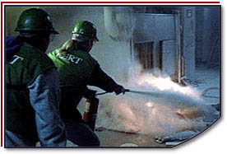
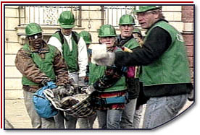
Purpose of On-Scene Management
Maintain physical safety of disaster workers
Maintain mental well being of disaster workers
Provide clear leadership and organizational structure
Improve effectiveness of rescue efforts

Slide 6
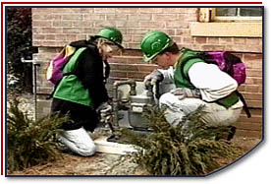
Objectives of CERT Organization
Identify the scope of the incident
What is the problem?
Determine an overall strategy
What can CERT do, and will they do it?
Deploy resources
Who is going to do what?
Document actions and results
If you didn’t write it down, it didn’t happen!

Slide 7
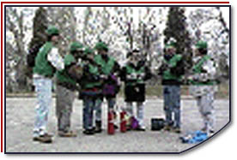
Incident Command System
ICS provides:
Well-defined management structure
Manageable span of control
Common terminology
Effective communication
Consolidated action plans
Comprehensive resource management
Accountability

Slide 8
Incident Command System
Key Concepts
Unity of Command – each CERT reports to only one person
Common terminology and organizational structure
Manageable Span of Control
Provides flexibility of resource management
Positions filled as needed
Modular units

Slide 9
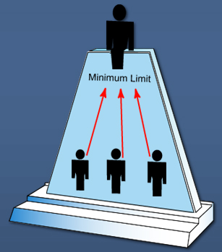
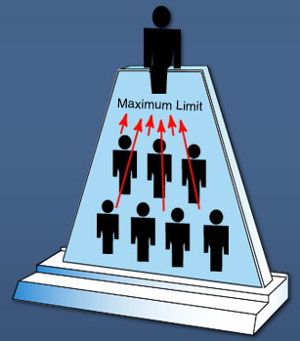
ICS Management
Span of Control
Is between 3 and 7 team members
Optimally does not exceed 5 team members

Slide 10
Incident Command System
The five major functional areas of ICS
Command
Operations
Planning / Intelligence
Logistics
Finance / Administration

Slide 11
Basic ICS Structure
Incident Commander
Public Information Officer
Liaison Officer
Safety Officer
Planning / Intelligence
Logistics
Finance / Administration
Operations
Notes:
This system can be used to manage anything
Planning a wedding?
Or any other event?
This organizational approach is effective
IC has Command Staff (SO, PIO, LO) and General Staff (Ops, Planning, Logs and Finance)

Slide 12
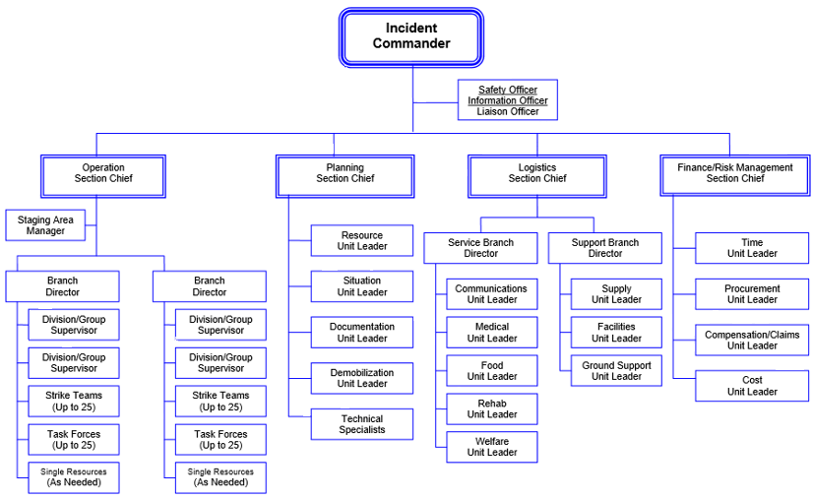
Complex ICS Structure
General Staff
Command Staff

Slide 13
CERT ICS
CERT
Team Leader
(Incident Commander)
Public Information Officer
Safety Officer
Operations
Planning / Intelligence
Logistics
Finance / Administration
CERT ICS Structure

Slide 14
Command and Control
Incident Commander – ”What to do”
CERT Leader
Operations – ”How to do it”
Manage the teams in the field
Planning / Intelligence – “What’s going on and what should happen next”
Collects and displays information and makes incident plans
Logistics – “How to support it”
Manage resources, supplies and equipment
Administration – “What gets recorded”
Collect and compile documentation

Slide 15
CERT Leader
Normally assumed by the first person on scene
Incident command post (ICP) location may be pre-established or it may be created by the CERT Leader
Leadership position may be transferred when a more qualified person arrives
CERT Leader may appoint CERT members to positions in Operations, Plans, Logistics, Administration, Safety Officer, etc. as incident expands

Slide 16
CERT Leader Duties
Is Incident Commander unless part of a larger ICS structure
Has overall responsibility for all CERT actions
Sets objectives and priorities
Assigns personnel as needed
Ensures coordination of staff actions and activities
Communicates with higher authorities (police, fire, EMS, EOC, etc.)

Slide 17
CERT Safety Officer
Reports to the CERT Leader
Assesses and anticipates hazardous and unsafe situations
Develops and recommends measures for assuring personnel health and safety
May develop a Site Safety Plan
Reviews the Incident Action Plan for safety implications
Can halt any operation at any time for safety concerns

Slide 18
Public Information Officer
Reports to the CERT Leader
Acts as the spokesperson for CERT under the direction of the CERT Leader
Assesses situation and prepares documents for release to the press and public that present a timely, accurate, consistent picture of the event
Reviews public social media accounts of the incident to correct any misinformation

Slide 19
Operations Section
Develops the operations tactics
Develops the Operations Section organizational structure
Conducts tactical operations to carry out the plan
Directs all operational resources deployed

Slide 20
Operations Section
Operations
Section
Medical
Group Leader
Transportation
Team
Treatment
Teams
Morgue Team
Supply Teams
Search & Rescue
Group Leader
S&R Team A
S&R Team B
S&R Team C
XXX
Group Leader
XXX
Team A
XXX
Team B
XXX
Team C

Slide 21
Planning / Intelligence Section
Planning
Develops the Incident Action Plan to accomplish the objectives defined for the event
Maintains resource status on all deployed personnel and equipment during the event
Maintains active incident documentation
May utilize Advance Planning to anticipate future needs
Intelligence
Collects and evaluates information
Validates information into intelligence

Slide 22
Logistics Section
Provides resources and all other services needed to support an incident:
Personnel
Food
Communications
Facilities
Transportation
etc.

Slide 23
Finance / Administration Section
Responsible for documenting costs related to incident
Provides accounting, procurement, time recording and cost analysis
Volunteer time is used for Federal matching dollars, and tracking is very important
The value in California was $33.61 per hour in 2020
Retains Documentation at end of event

Slide 24
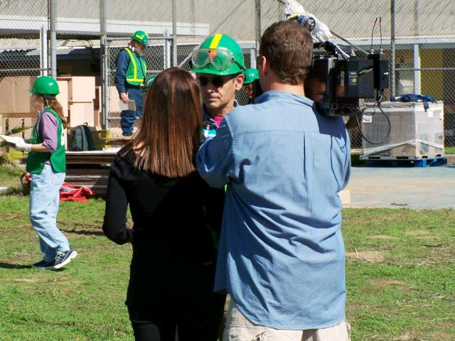
Dealing with the Media
You may get questions from the public or from media representatives
Refer inquiries to CERT Team Leader, Incident Commander, or Public Information Officer
Do not let media interfere with CERT activities
Do not divulge any sensitive information

Slide 25
National Incident Management System
NIMS provides ability to work together
IS-100: Introduction to ICS https://training.fema.gov/is/courseoverview.aspx?code=IS-100.c
IS-700: Introduction to NIMS https://training.fema.gov/is/courseoverview.aspx?code=IS-700.b

Slide 26
CERT Mobilization
CERTs take care of themselves, their family, their home, and their neighbors
Depending on local CERT protocols, CERT members may respond to pre-designated locations, ready for response
CERT organization should have effective communications, a manageable span of control and maintain accountability
The greatest good for the greatest number without placing CERT members in harms way

Slide 27
CERT Mobilization
CERT Leader will develop an organization plan
Priorities may change as operation continues; CERT Leader needs to stay on top of these shifting priorities
Communications must be organized, efficient and effective
ICS was developed to assist in the management of major incidents – Use it
Goal is always to do the greatest good for the greatest number of people while maintaining CERT safety

Slide 28
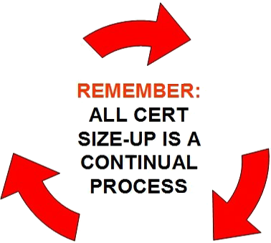
On-Scene Size-up
Gather Facts
Assess and Communicate Damage
Consider Probabilities
Asses Your Own Situation
Establish Priorities
Make Decisions
Develop Plan of Action
Take Action
Evaluate Progress

Slide 29
Documentation
Each level of authority is responsible for documentation (CERT Leader, Ops, Plans, Logs, Admin)

Slide 30
Documentation
CERT Teams provide the Command Post with ongoing information and documentation on:
Damage assessment
Team status
Ongoing needs
Command Post documents:
Incident status
Incident locations: access routes and identified hazards
Support locations: Staging areas, treatment/triage areas and morgue

Slide 31
CERT Forms
Damage Assessment
Personnel Resources Sign-in (ICS-211)
Incident/Assignment Tracking Log (ICS-204)
Briefing/Assignment (ICS-201/203)
Victim Treatment Area Record
Communications Activity Log (ICS-214)
Equipment Inventory (ICS-209/210)
General Message (ICS-213)

Slide 32
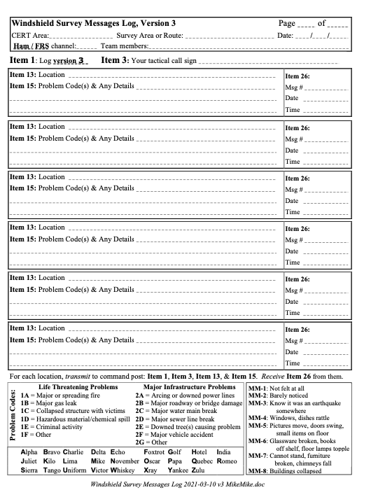
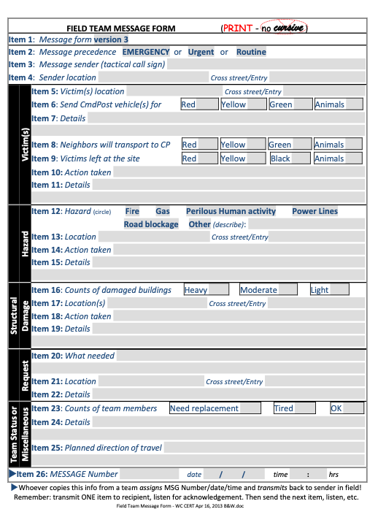
Walnut Creek CERT Forms

Slide 33
Questions?

Slide 34
Takeaways
CERTs operate using ICS
ICS, the Incident Command System:
Flexible and Scalable
Span of Control
Modular Command Structure
Common Terminology
Document, Document, Document

